Slide 1
Graph Neural Networks on Heterogeneous Graphs

Slide 2
Goal:
So far we only handle graphs with one edge type.
How to handle (directed) graphs with multiple edge types (a.k.a heterogeneous graphs)?
Heterogeneous Graphs are common
Relational GCNs
Knowledge Graphs
Embeddings for KG Completion
2

Slide 3
Heterogeneous Graphs and Relational GCN (RGCN)

Slide 4
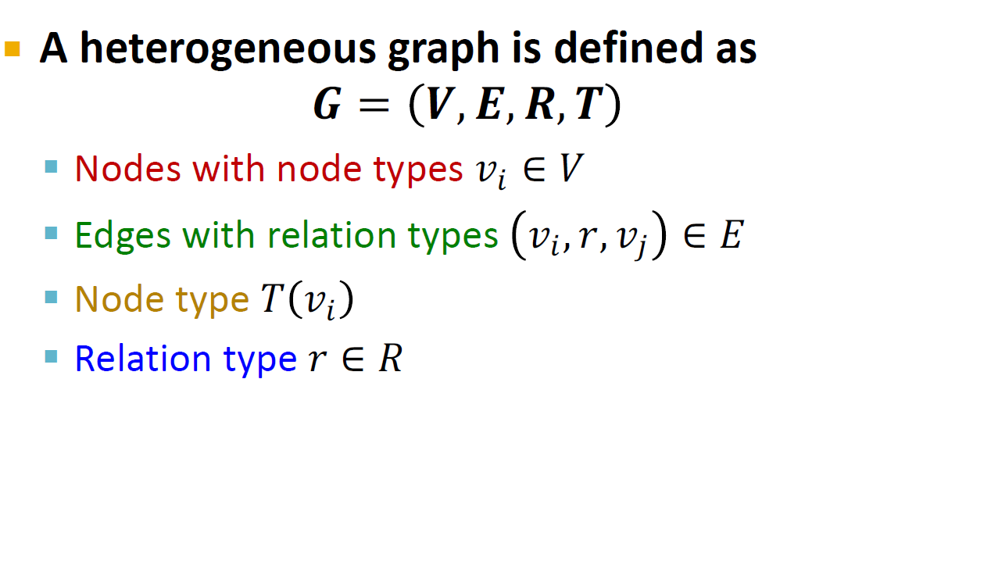
A heterogeneous graph is defined as
𝑮 = 𝑽, 𝑬, 𝑹, 𝑻
Nodes with node types 𝑣! ∈ 𝑉
Edges with relation types 𝑣!, 𝑟, 𝑣" ∈ 𝐸
Node type 𝑇 𝑣!
Relation type 𝑟 ∈ 𝑅
4

Slide 5
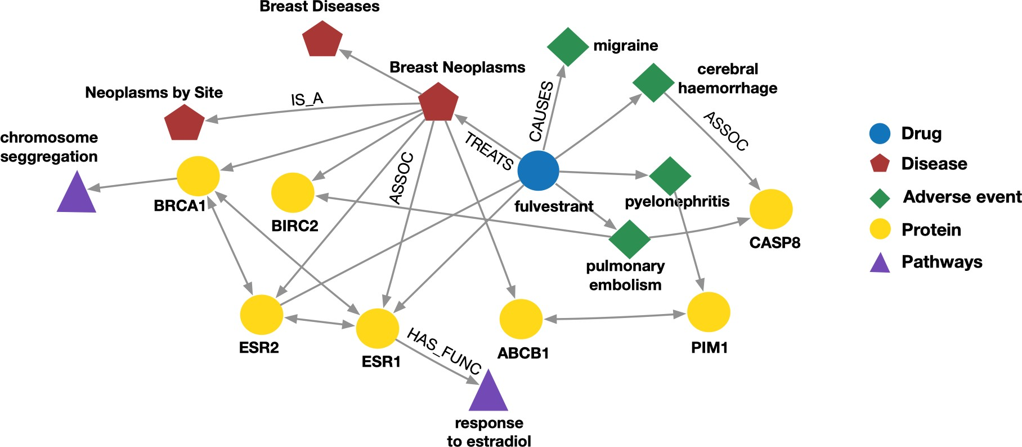
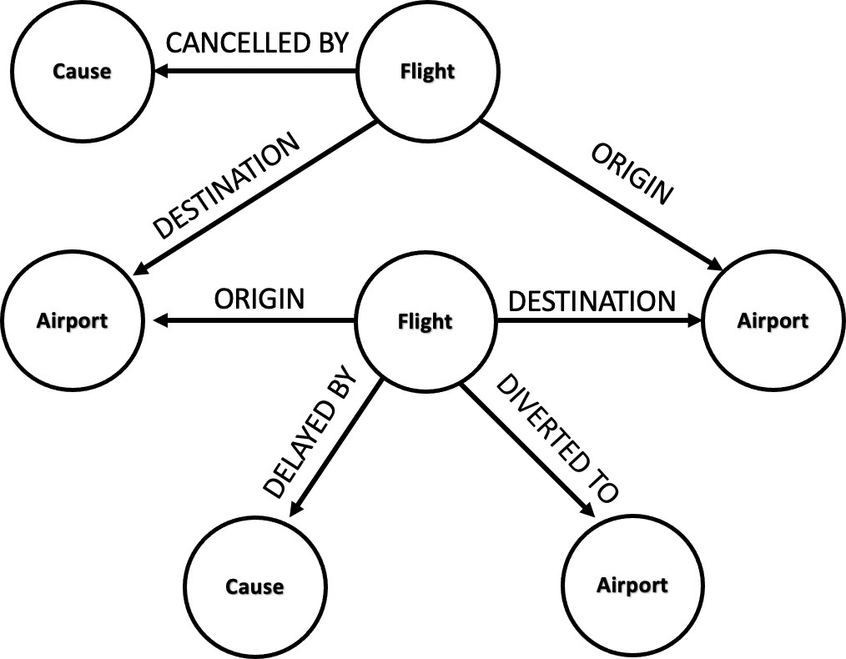
Event Graphs
Example node: SFO
Example edge: (UA689, Origin, LAX) Example node type: Flight
Example edge type (relation): Destination
Biomedical Knowledge Graphs
Example node: Migraine
Example edge: (fulvestrant, Treats, Breast Neoplasms) Example node type: Protein
Example edge type (relation): Causes
5

Slide 6

Schlichtkrull et al., Modeling Relational Data with Graph Convolutional Networks, ESWC 2018
We will extend GCN to handle heterogeneous graphs with multiple edge/relation types
We start with a directed graph with one relation
How do we run GCN and update the representation of the target node A on this graph?
Target Node
A
B
C
E
Input Graph
F
D
6

Slide 7
We will extend GCN to handle heterogeneous graphs with multiple edge/relation types
We start with a directed graph with one relation
How do we run GCN and update the representation of the target node A on this graph?
Target Node
A
B
Only pass messages along direction of edges
C
B
C
F
A
C
E
Input Graph
F
D
E
D
7

Slide 8
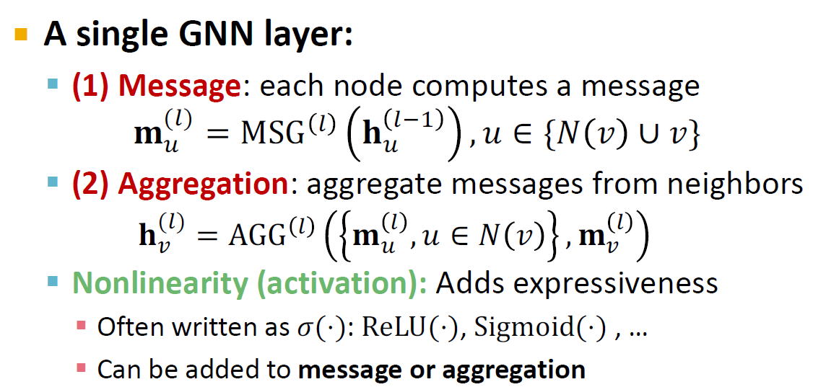

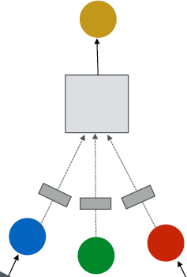
A single GNN layer:
(1) Message: each node computes a message
_{𝐡} %'(
𝐦^{(%)} = MSG %
, 𝑢 ∈ {𝑁 𝑣 ∪ 𝑣}
# #
(2) Aggregation: aggregate messages from neighbors
𝐡^{(#)} = AGG # 𝐦 # , 𝑢 ∈ 𝑁 𝑣
, 𝐦 #
! % !
Nonlinearity (activation): Adds expressiveness
Often written as 𝜎(⋅): ReLU(⋅), Sigmoid(⋅) , …
Can be added to message or aggregation
(2) Aggregation
(1) Message
8

Slide 9
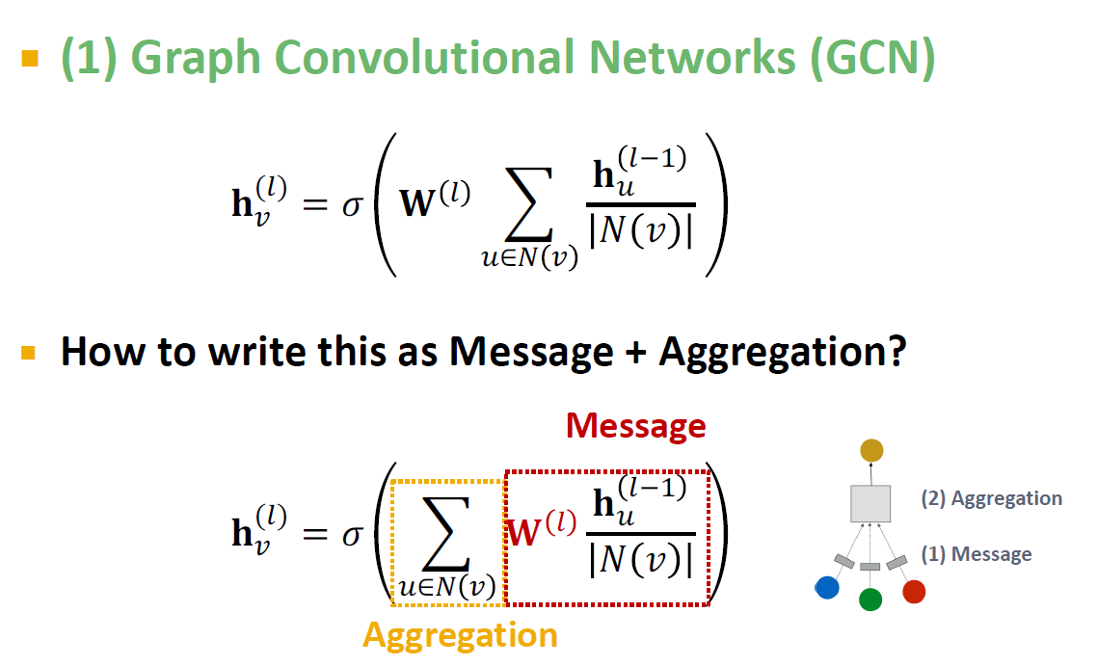


Kipf and Welling. Semi-Supervised Classification with Graph Convolutional Networks, ICLR 2017
(1) Graph Convolutional Networks (GCN)
_{𝐡} #()
(#)
_{𝐖} #
2
%∈' !
%
𝐡! = 𝜎
𝑁 𝑣
How to write this as Message + Aggregation?
Message
_{𝐡} #()
𝐡! = 𝜎 2
%∈' !
_{𝐖} #
(2) Aggregation
(#)
%
𝑁 𝑣
(1) Message
Aggregation
9

Slide 10

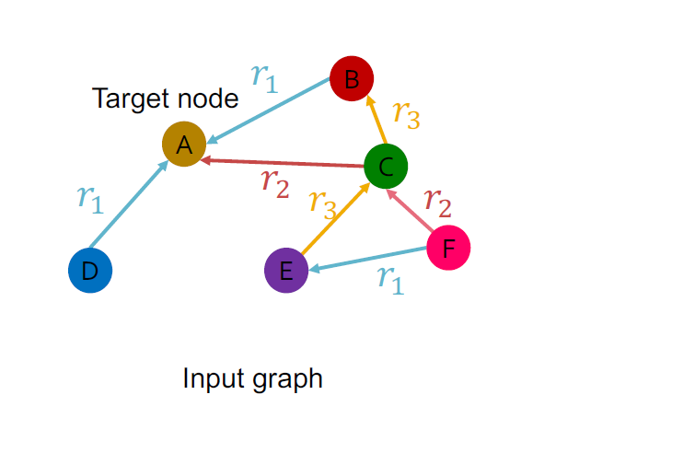
What if the graph has multiple relation types?
𝑟₎
B
𝑟₊
C
Target node
A
𝑟
𝑟
)
*
𝑟
𝑟
+
*
F
D
E
𝑟₎
Input graph
10

Slide 11
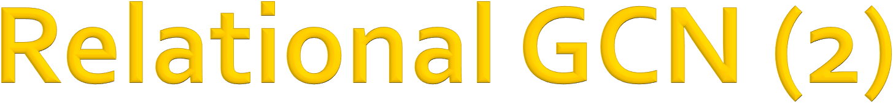
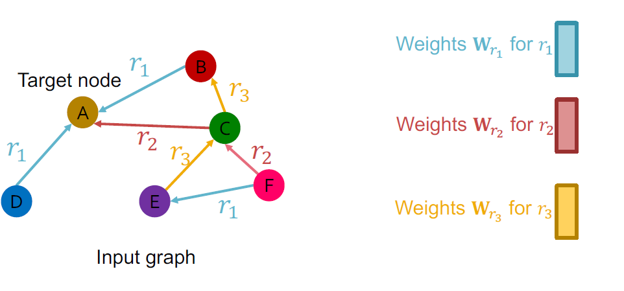
What if the graph has multiple relation types?
Use different neural network weights for different relation types.
Weights 𝐖!! for 𝑟"
𝑟
B
Target node
A
)
𝑟
+
𝑟
* _{𝑟}
C
Weights 𝐖! for 𝑟#
𝑟
𝑟
"
)
+
*
F
D
E
𝑟₎
Weights 𝐖!# for 𝑟$
Input graph
11

Slide 12

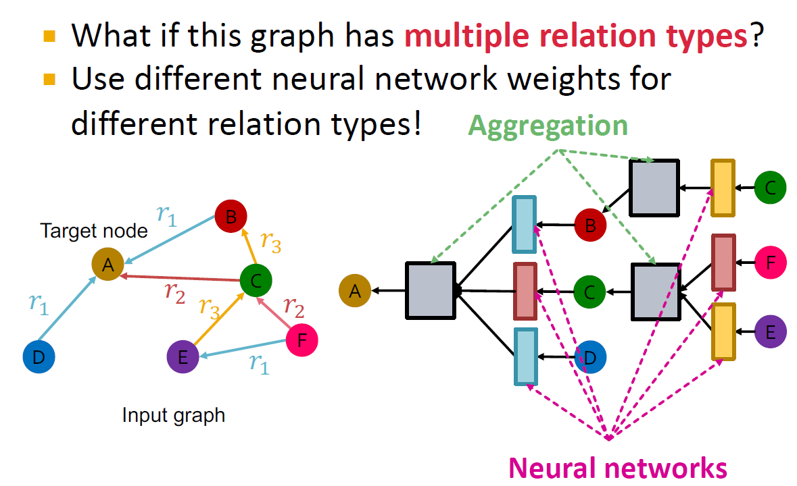
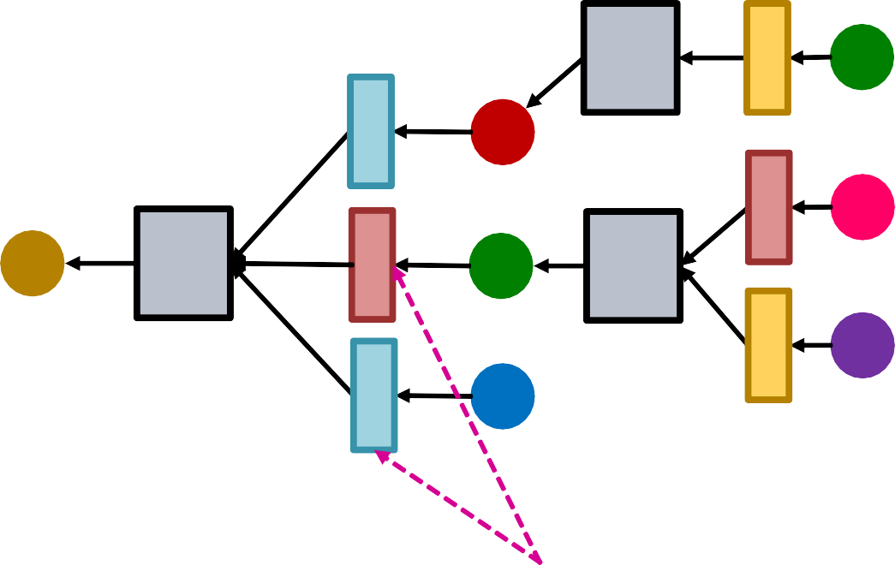
What if this graph has multiple relation types?
Use different neural network weights for
different relation types!
Aggregation
C
𝑟₎
Target node
A
B
𝑟
B
+
F
𝑟
C
A
C
𝑟
*
𝑟
𝑟
)
+
*
F
E
D
E
𝑟₎
D
Input graph
Neural networks
12
Notes:
I don’t get it

Slide 13
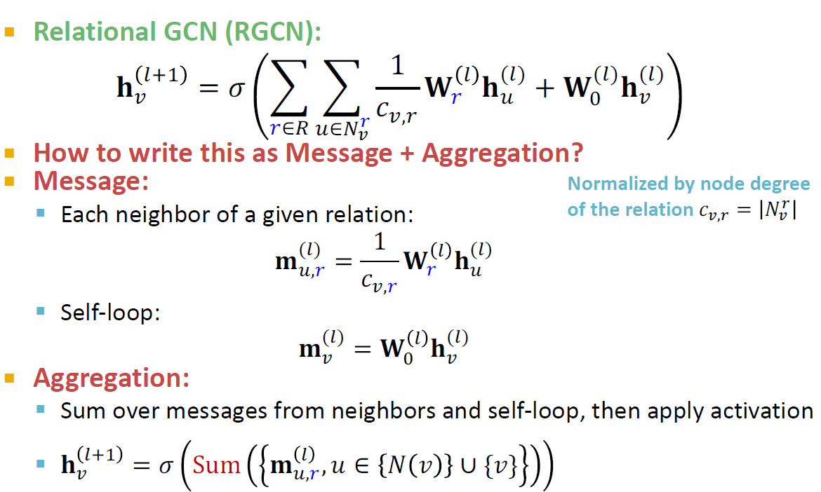




Relational GCN (RGCN):
_{𝐡} #.)
1
= 𝜎 % %
#
(#)
(#) (#)
𝐖 𝐡
+ 𝐖 𝐡
!
^{𝑐}!,/
/ %
2
!
/∈0 %∈'"
!
How to write this as Message + Aggregation?
Message:
Each neighbor of a given relation:
Normalized by node degree
of the relation 𝑐%,! = 𝑁!
%
_{𝐦}(%) ₌
1
(%)
# !
%
𝐖 𝐡
!,#
^{𝑐}',#
Self-loop:
_{𝐦}(%) _{= 𝐖} % _{𝐡}(%)
' ( '
Aggregation:
Sum over messages from neighbors and self-loop, then apply activation
_{𝐡} %)* _{𝐦} %
' !,#
= 𝜎 Sum , 𝑢 ∈ 𝑁 𝑣 ∪ {𝑣}
13

Slide 14

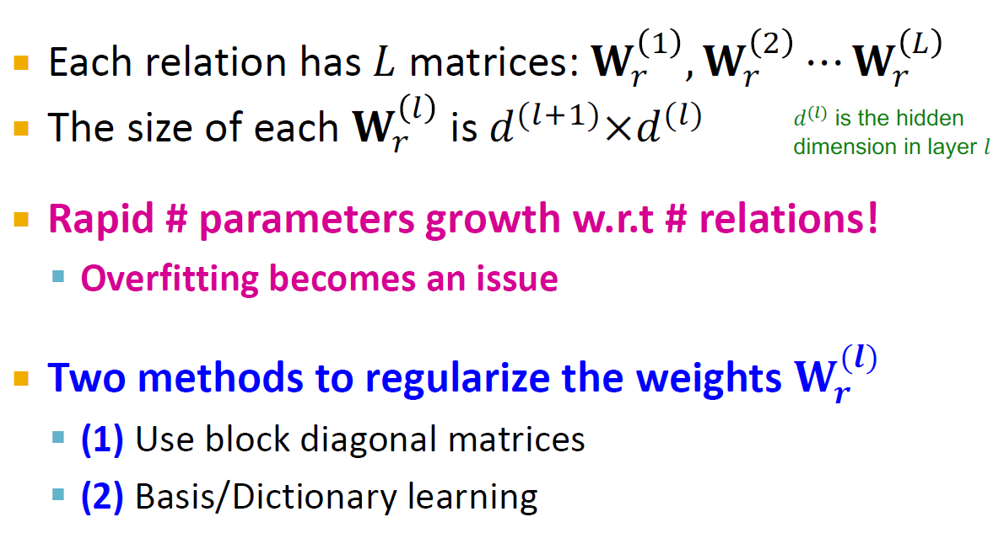
Each relation has 𝐿 matrices: 𝐖!" , 𝐖!#
⋯ 𝐖!$
𝑑^{(")} is the hidden dimension in layer 𝑙
_{is 𝑑}(%'")_{×𝑑}(%)
The size of each 𝐖!%
Rapid # parameters growth w.r.t # relations!
Overfitting becomes an issue
Two methods to regularize the weights 𝐖^{(𝒍)}
𝒓
(1) Use block diagonal matrices
(2) Basis/Dictionary learning
14

Slide 15
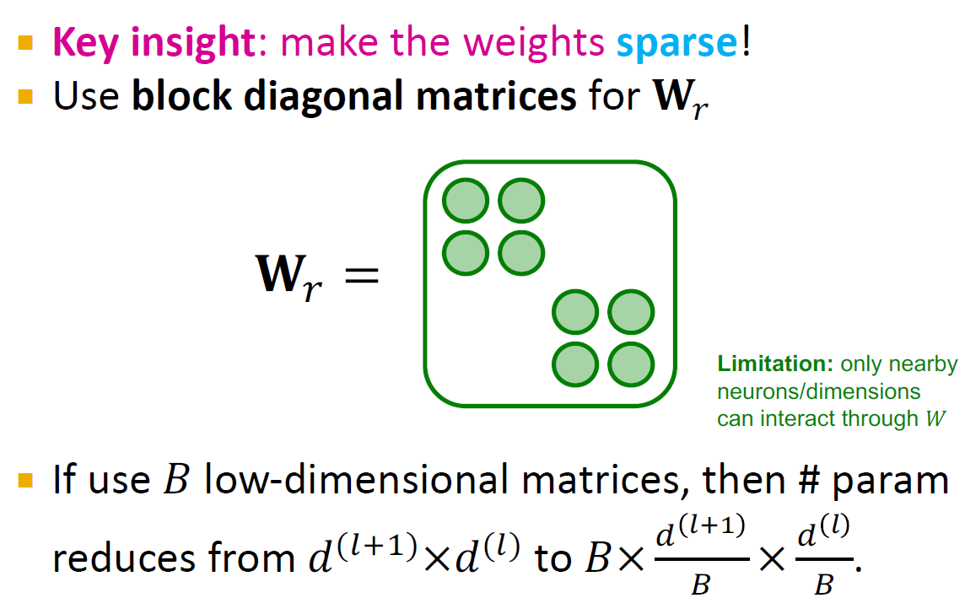

Key insight: make the weights sparse!
Use block diagonal matrices for 𝐖!
𝐖₄ =
Limitation: only nearby neurons/dimensions can interact through 𝑊
If use 𝐵 low-dimensional matrices, then # param
reduces from 𝑑^{(%'")}×𝑑^{(%)} to 𝐵× ^{+ &'(} × ^{+ &} .
, ,
15

Slide 16
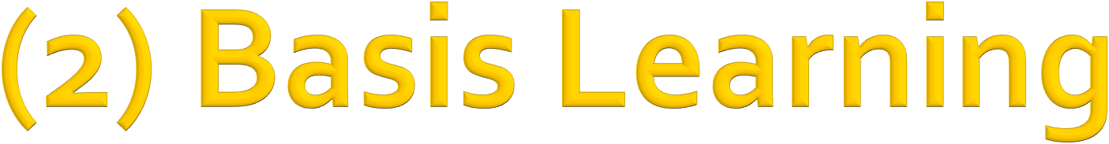
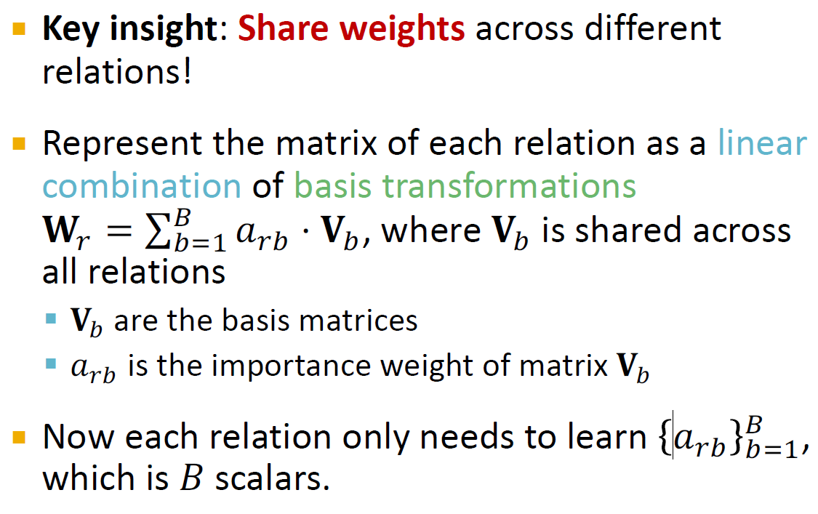
Key insight: Share weights across different relations!
Represent the matrix of each relation as a linear combination of basis transformations
𝐖! = ∑, 𝑎_{!-} ⋅ 𝐕₋, where 𝐕₋ is shared across
-."
all relations
𝐕₎ are the basis matrices
𝑎_{*)} is the importance weight of matrix 𝐕₎
Now each relation only needs to learn 𝑎_{!-} , ,
-."
which is 𝐵 scalars.
16

Slide 17
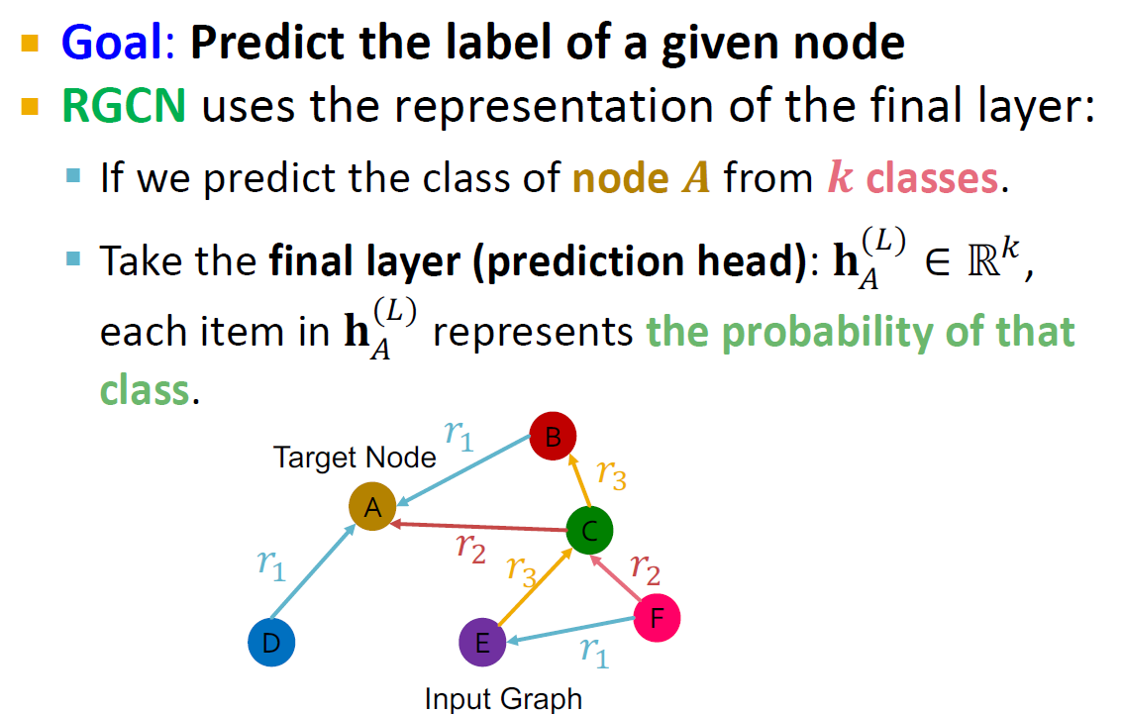
Goal: Predict the label of a given node
RGCN uses the representation of the final layer:
If we predict the class of node 𝑨 from 𝒌 classes.
Take the final layer (prediction head): 𝐡^{(,)} ∈ ℝ⁻,
+
each item in 𝐡^{(,)} represents the probability of that
+
class.
𝑟₎
B
𝑟₊
C
Target Node
A
𝑟
𝑟
)
*
𝑟
𝑟
+
*
F
D
E
𝑟₎
Input Graph
17

Slide 18










Link prediction split:
Every edge also has a relation type, this is independent of the 4 categories.
In a heterogeneous graph, the homogeneous graphs formed by every single relation also have the 4 splits.
2
2
1
3
1
3
Split
5 4
The original graph
5 4
Split Graph with 4 categories of edges
Training message edges for 𝒓_{𝟏} Training supervision edges for 𝒓_{𝟏} Validation edges for 𝒓_{𝟏}
Test edges for 𝒓_{𝟏}
Training message edges Training supervision edges Validation edges
Test edges
…..
Training message edges for 𝒓_{𝒏} Training supervision edges for 𝒓_{𝒏} Validation edges for 𝒓_{𝒏}
Test edges for 𝒓_{𝒏}
18

Slide 19
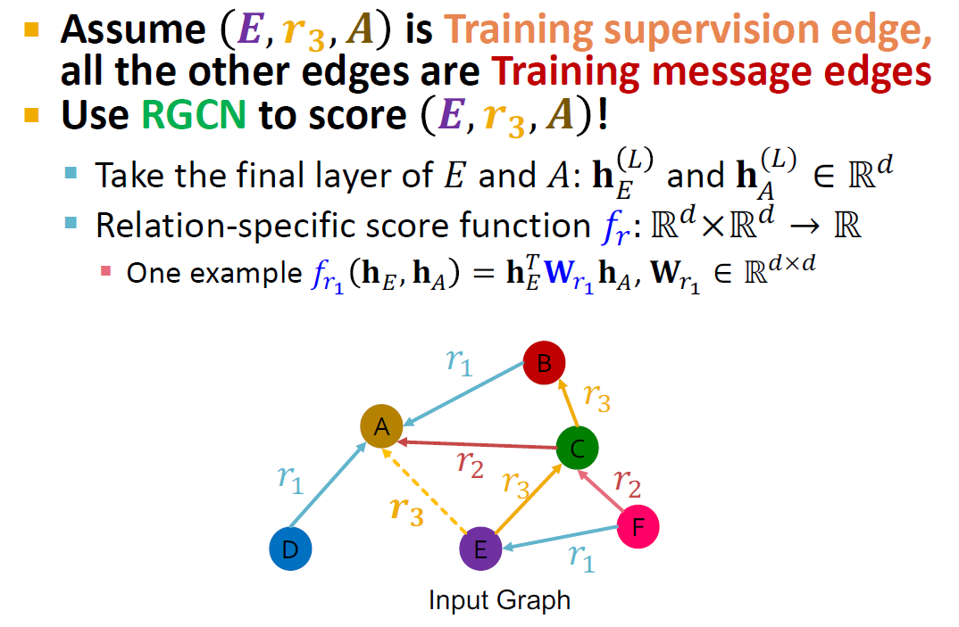
Assume 𝑬, 𝒓_{𝟑}, 𝑨 is Training supervision edge, all the other edges are Training message edges
Use RGCN to score 𝑬, 𝒓_{𝟑}, 𝑨 !
Take the final layer of 𝐸 and 𝐴: 𝐡 * and 𝐡^{(*)} ∈ ℝ,
) +
Relation-specific score function 𝑓₋: ℝ,×ℝ, → ℝ
One example 𝑓# 𝐡., 𝐡/ = 𝐡⁰ 𝐖# 𝐡/, 𝐖#
_{∈ ℝ}1×1
.
) ) )
𝑟₎
B
𝑟₊
C
A
𝑟
𝑟
)
*
𝑟
𝑟
𝒓
+
*
𝟑
F
D
E
𝑟₎
Input Graph
19

Slide 20
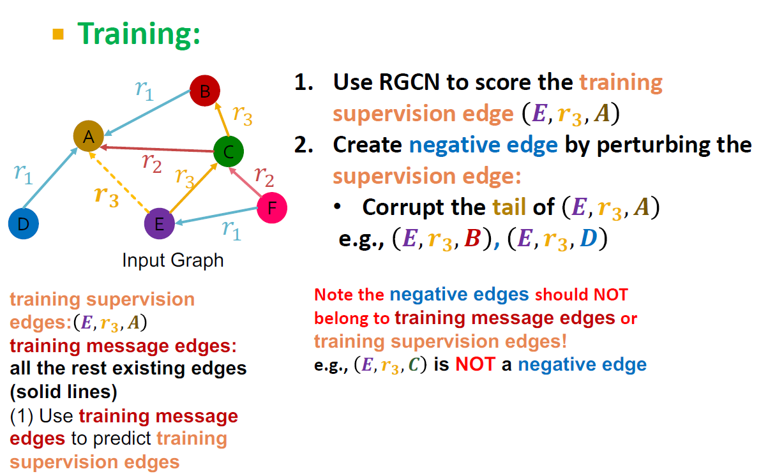
Training:
𝑟₎
𝑟₊
C
Use RGCN to score the training supervision edge 𝑬, 𝒓_{𝟑}, 𝑨
Create negative edge by perturbing the supervision edge:
Corrupt the tail of 𝑬, 𝒓_{𝟑}, 𝑨
e.g., 𝑬, 𝒓_{𝟑}, 𝑩 , 𝑬, 𝒓_{𝟑}, 𝑫
B
A
𝑟₎
D
𝑟
* _{𝑟+}
E
𝑟*
F
𝒓
𝟑
𝑟₎
Input Graph
training supervision edges: 𝑬, 𝒓_{𝟑}, 𝑨
training message edges: all the rest existing edges (solid lines)
(1) Use training message edges to predict training supervision edges
Note the negative edges should NOT belong to training message edges or training supervision edges!
e.g., 𝑬, 𝒓_{𝟑}, 𝑪 is NOT a negative edge
20

Slide 21
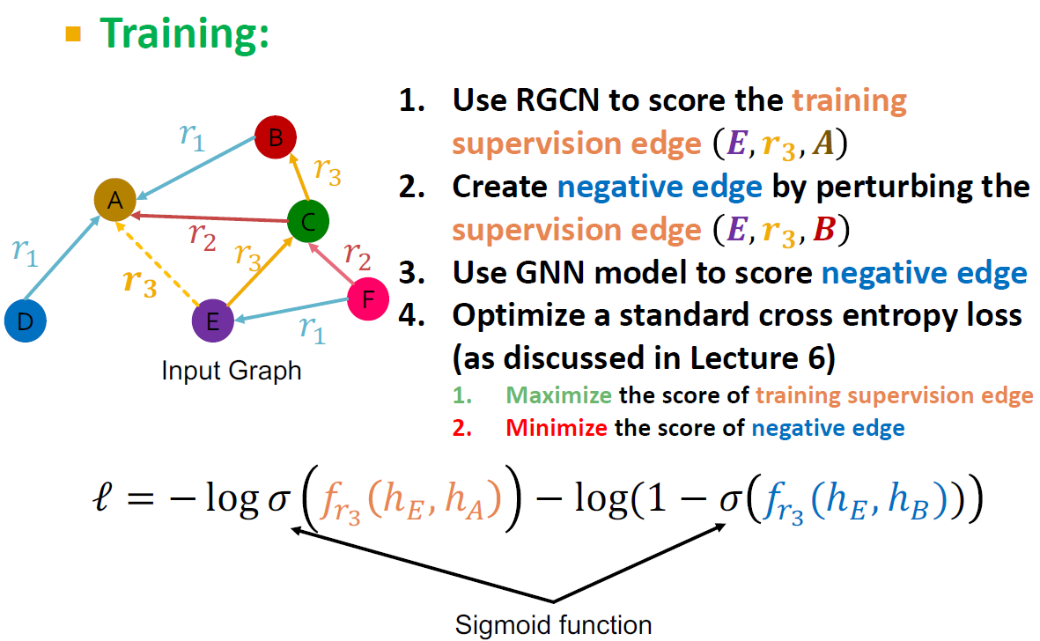

Training:
Use RGCN to score the training supervision edge 𝑬, 𝒓_{𝟑}, 𝑨
Create negative edge by perturbing the supervision edge 𝑬, 𝒓_{𝟑}, 𝑩
Use GNN model to score negative edge
Optimize a standard cross entropy loss (as discussed in Lecture 6)
Maximize the score of training supervision edge
Minimize the score of negative edge
𝑟₎
B
𝑟
+
A
𝑟
C
𝑟
*
𝑟
𝑟
)
𝒓
+
*
𝟑
F
D
E
𝑟
)
Input Graph
ℓ = − log 𝜎 𝑓*!
ℎ., ℎ₊ − log(1 − 𝜎 𝑓*! (ℎ., ℎ/))
Sigmoid function
21

Slide 22
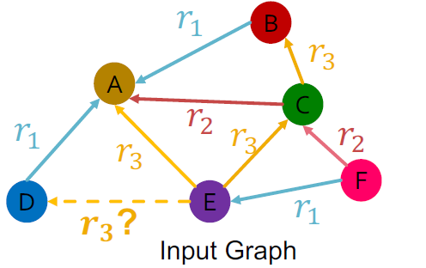
Evaluation:
Validation time as an example, same at the test time
𝑟₎
B
𝑟
Evaluate how the model can predict the validation edges with the relation types. Let’s predict validation edge 𝑬, 𝒓_{𝟑}, 𝑫 Intuition: the score of 𝑬, 𝒓_{𝟑}, 𝑫 should be
higher than all 𝑬, 𝒓_{𝟑}, 𝒗 where 𝑬, 𝒓_{𝟑}, 𝒗 is NOT in the training message edges and training supervision edges, e.g., 𝑬, 𝒓_{𝟑}, 𝑩
+
A
𝑟
* _{𝑟+}
E
C
𝑟*
F
𝑟₎
D
𝑟
+
𝑟₎
𝒓_{𝟑}?
Input Graph
validation edges: 𝑬, 𝒓_{𝟑}, 𝑫
training message edges & training supervision edges: all existing edges (solid lines)
(2) At validation time:
Use training message edges & training supervision edges to predict validation edges
22

Slide 23
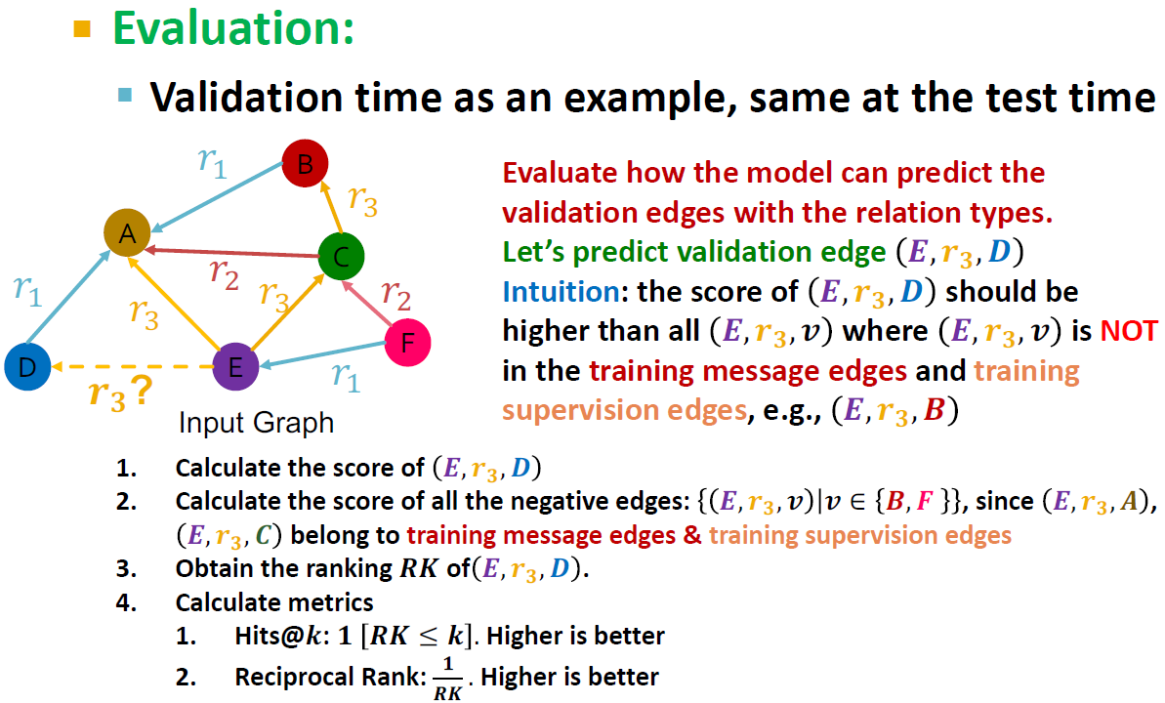
Evaluation:
Validation time as an example, same at the test time
𝑟₎
B
𝑟
Evaluate how the model can predict the validation edges with the relation types. Let’s predict validation edge 𝑬, 𝒓_{𝟑}, 𝑫 Intuition: the score of 𝑬, 𝒓_{𝟑}, 𝑫 should be
higher than all 𝑬, 𝒓_{𝟑}, 𝒗 where 𝑬, 𝒓_{𝟑}, 𝒗 is NOT in the training message edges and training supervision edges, e.g., 𝑬, 𝒓_{𝟑}, 𝑩
+
A
𝑟
* _{𝑟+}
E
C
𝑟*
F
𝑟₎
D
𝑟
+
𝑟₎
𝒓_{𝟑}?
Calculate the score of 𝑬, 𝒓_{𝟑}, 𝑫
Calculate the score of all the negative edges: 𝑬, 𝒓_{𝟑}, 𝒗 𝒗 ∈ 𝑩, 𝑭 , since 𝑬, 𝒓_{𝟑}, 𝑨 ,
Input Graph
𝑬, 𝒓_{𝟑}, 𝑪 belong to training message edges & training supervision edges
Obtain the ranking 𝑹𝑲 of 𝑬, 𝒓_{𝟑}, 𝑫 .
Calculate metrics
Hits@𝒌: 𝟏 𝑹𝑲 ≤ 𝒌 . Higher is better
𝟏
2. Reciprocal Rank: . Higher is better
𝑹𝑲
23

Slide 24

Relational GCN, a graph neural network for
heterogeneous graphs
Can perform entity classification as well as link prediction tasks.
Ideas can easily be extended into RGNN (RGraphSAGE, RGAT, etc.)
24

